Slide 1
PYSINDY PREBIOTIC CHEMISTRY FALL 2021
AYAN DEEP HAZRA

Slide 2

FOCUS OF THE PROJECT/PROBLEM CONSIDERATIONS
We have a limited understanding of the chemistry which led to the formation of life on this planet. One of the major challenges is the combinatorial explosion that occurs when unspecific chemistries are used to synthesize sequence-specific polymers, like proteins.
We aim to investigate the kinetics of amino acids forming peptides in prebiotic systems, a process containing hundreds of potential reactions and thus requires advanced network reconstruction tools.

Slide 3
BEGININGS OF PROJECT, GOAL
The project was initially seeking to use RING to categorically and systematically classify the types of glycine and alanine reactions that can occur given a set of constraints, such as polymer length, number of active centres, etc.
We realized that there were multiple problems with using RING.
Switched to using PYSINDY instead. Would start with a “true” model, i.e. lab generated results, try to simulate over a given timeframe, use the datapoints from the generation to try and recover the system. Would also try to add in noise over the simulation data, to see where and how the model falls apart.
Idea being, this might give us some insight on how real-life data collection is affected by noise and disturbance.

Slide 4
LAB RESULTS
We focused on the reactions between Glycine and Alanine that would produce polymers of the two.
G + A -> G + A + GG + AA + GA
Our wet lab derived data for 10 such species, and on the computation side, we analyzed a toy-model of just 5 species (the ones above) to gauge some understanding of the kinetics.

Slide 5
WHAT IS PYSINDY?
Py-Sindy is a python package for the sparse identification of nonlinear dynamics from data.
Allows one to generate a system of differential equations for n species depending on a fixed amount of values.
Can forward simulate generated DE’s to test the physical relevance and reliability of equations.

Slide 6
APPROACH 1

Slide 7
APPROACH 1
This approach would take the original model and simulate different starting conditions and analyze the dynamics of the system till a end point, then it would repeat that for several random starting conditions. It would then combine all this data in a large matrix and feed it into the model, which would generate what the expected system is.
The first approach did not yield good recovery of the model, and this seems to be because Py-Sindy performs much better when a lot of a the change and non-linearity in the system is recorded much better than the linear data.

Slide 8
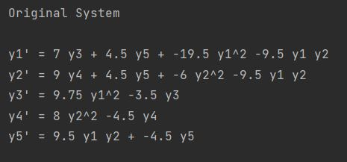
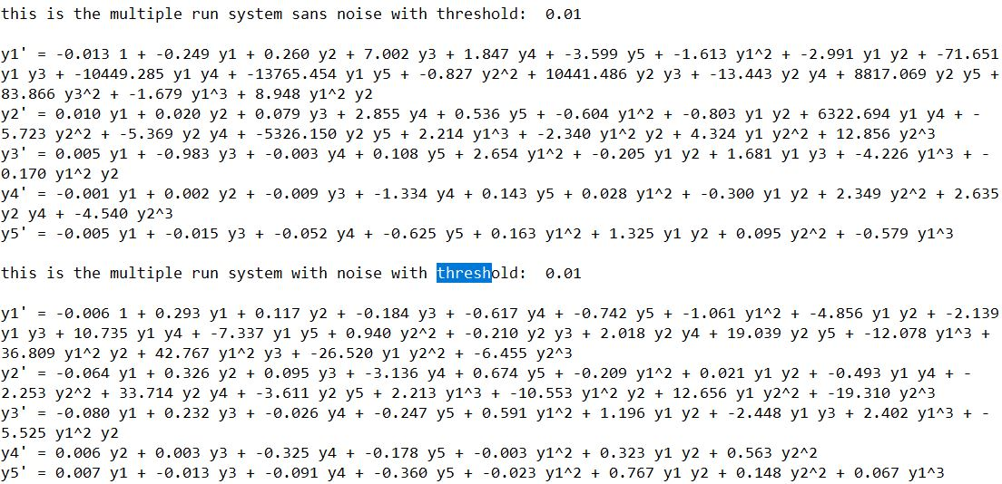
EXAMPLE 1, Threshold = 10^-2
Recovery is pretty bad, neither the expected terms’ coefficients match, nor do the number of expected terms match, some are missing and some are incorrectly added in the recovered vs the original.

Slide 9
APPROACH II

Slide 10
APPROACH II
This approach works better because the data collection is skewed to the part of the system where the majority of change occurs.
Random datapoints are the only inputs of the data, but they’re not a series of runs, just individual datapoints based on the initial starting conditions.
In general, is able to recover system much better, both with and without noise. Depending on the degree of noise and the frequency of sampling, it could be several orders of magnitude better.

Slide 11
TIMEPOINTS
t_span = np.arange(0, 2, 0.0002)
Changed the gap to allow for different frequencies of data collection. Smaller values indicated more collection, larger 3 of timepoints.
Start and end was always 0 and 2. Reason being that the curve flattened around 2 almost always.

Slide 12
BEST RUN

Slide 13
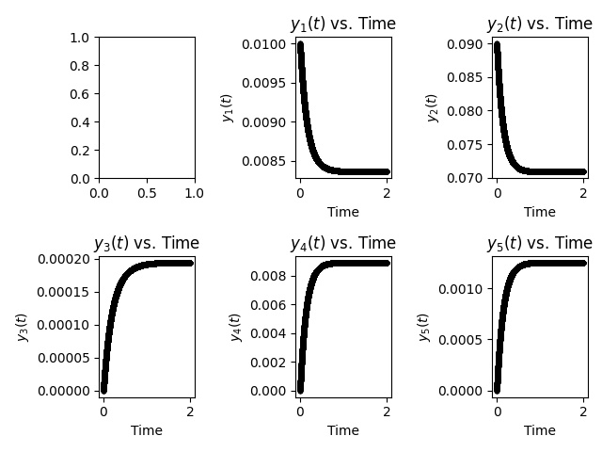

10-90 (g+a->gg+aa+ga/ag) initial conditions for simulation
Y1->G
Y2->A
Y3->GG
Y4->AA
Y5
->GA/AG
NO-NOISE RECOVERED MODEL
NOISE RECOVERED MODEL

Slide 14
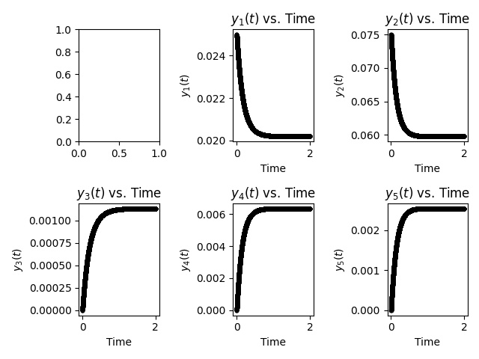

25-75 (g+a->gg+aa+ga/ag) initial conditions for simulation
Y1->G
Y2->A
Y3->GG
Y4->AA
Y5
->GA/AG
NO-NOISE RECOVERED MODEL
NOISE RECOVERED MODEL

Slide 15
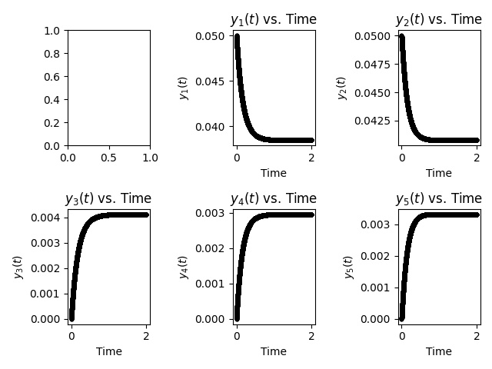

50-50 (g+a->gg+aa+ga/ag) initial conditions for simulation
Y1->G
Y2->A
Y3->GG
Y4->AA
Y5
->GA/AG
NO-NOISE RECOVERED MODEL
NOISE RECOVERED MODEL

Slide 16
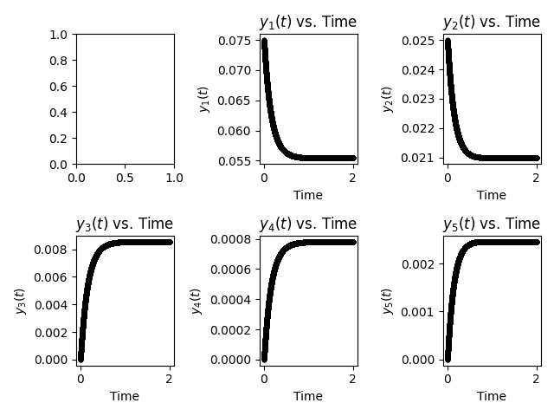

75-25 (g+a->gg+aa+ga/ag) initial conditions for simulation
Y1->G
Y2->A
Y3->GG
Y4->AA
Y5
->GA/AG
NO-NOISE RECOVERED MODEL
NOISE RECOVERED MODEL

Slide 17
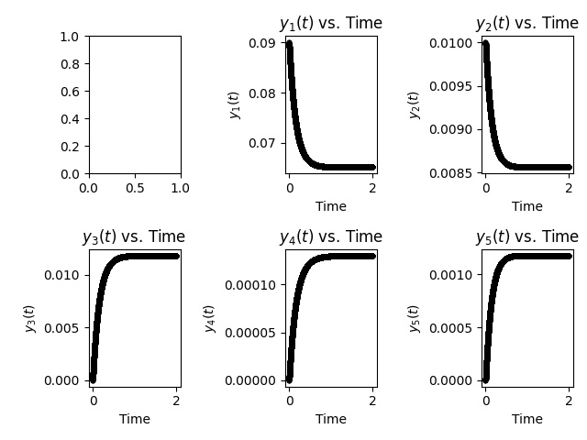

90-10 (g+a->gg+aa+ga/ag) initial conditions for simulation
Y1->G
Y2->A
Y3->GG
Y4->AA
Y5
->GA/AG
NO-NOISE RECOVERED MODEL
NOISE RECOVERED MODEL

Slide 18
ERROR CALCULATION
We calculate the difference of each coefficient in the noise recovered matrix vs the no-noise recovered matrix. We add the absolute value of each term and divide the whole with the sum of the absolute coefficients of the no-noise matrix. We then calculate a error ratio which determines the viability of a particular run with set standard deviation and # of timepoints.

Slide 19
